Slide 1
GEOMETRY NODES MODIFIER
By – Harshit Bhandari 20030121038
Sukhwinder Singh 20030121111

Slide 2
What is Geometry Nodes Modifier ?
It creates a procedural way to create or modify the geometry in our scene.
It Basically lets you perform actions based on the rules that you define.
It was First Introduced in blender 2.9

Slide 3
Geometry Nodes Editor
3D View – The default Screen of blender
Nodes Tree/Graph – Similar to the shader graph ( Default Input and Output Node)
Spreadsheet – It shows the exact Coordinates of the vertices, edges, Faces and many more things.

Slide 4
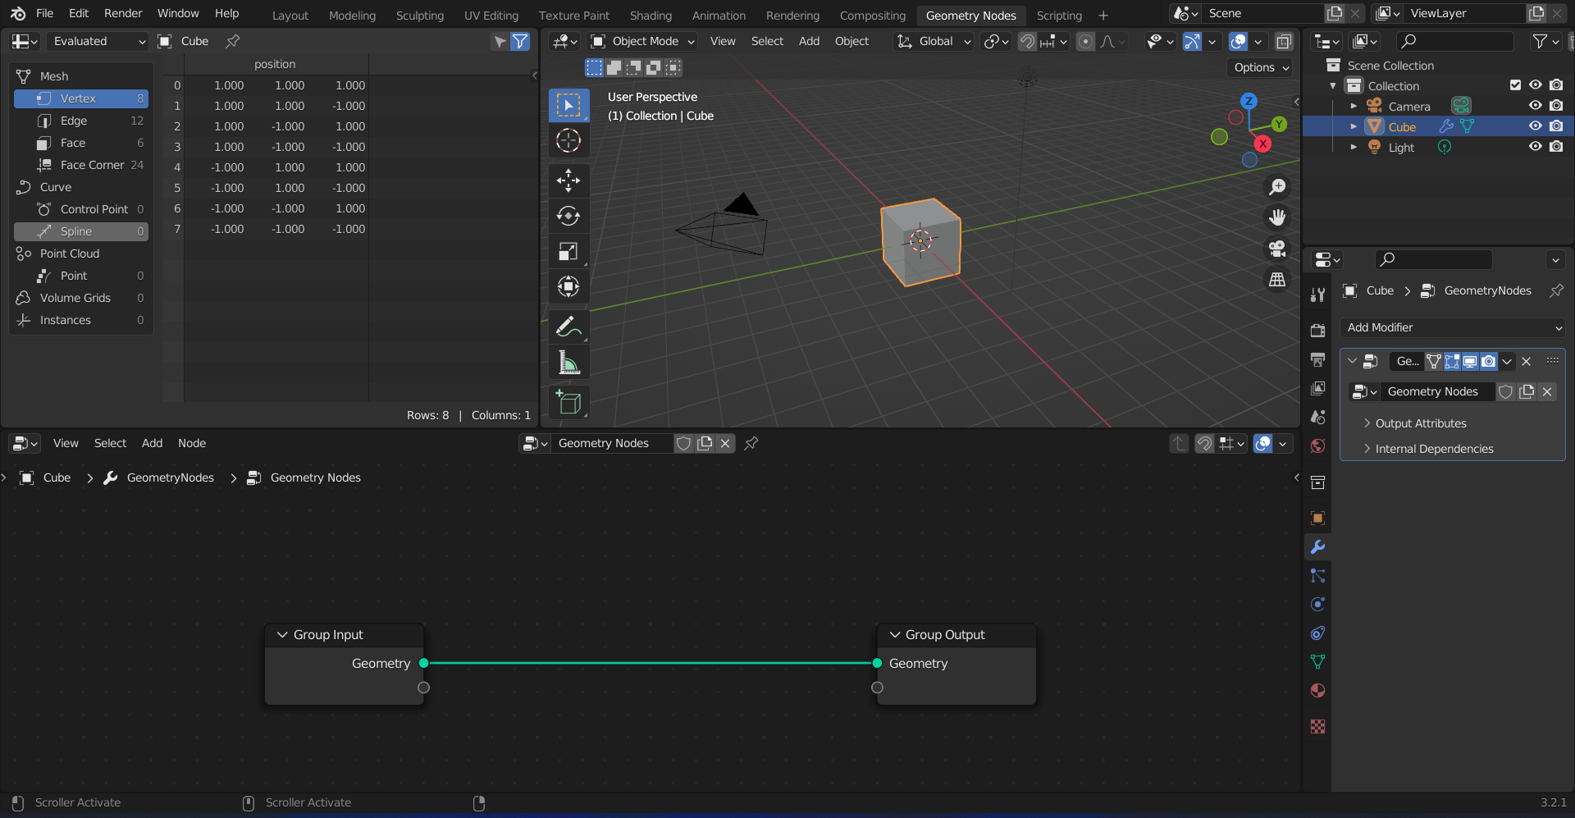
Geometry Nodes Editor

Slide 5
Nodes Graph
To add new nodes you can use Shift + A.
To add a node to the network just drag it in between two nodes.
To disconnect a node form the network simply hold Alt and drag the node outside the network.

